Slide 1

ErlIDE
A modern GUI for erlang development
Notes:
Before I begin, I'd like to ask a couple of questions:
- how many people here have used Erlide?
- how many have tried Erlide?
- how many use something else than Emacs? (... oh, okay, I will skip the Emacs jokes ...)
Oh, if anything is unclear or we go too fast, please don't hesitate to interrupt and ask. Hopefully we'll be able to explain better.
Okay... Now, first things first. The most important question is, I believe: how do you pronounce this name? Fortunately, the answer is simple: in any way you see fit. Me, I do it “swedish-style”: erlide.

Slide 2
Eclipse
An extensible platform for developing applications
100% Open Source
100% java
created by IBM
Many platforms
(Windows, Mac, Linux, Solaris)
Notes:
For the benefit of those who aren't familiar with erlide, what is this thing, anyway? Well, as the name implies, it is an integrated development for Erlang, build upon the Eclipse platform.
If anyone isn't familiar with Eclipse, it is an extensible platform for building applications upon, with the main focus being development environments. It is written in Java, it is open-sourced and at the core of its extensibility lie the concept of plug-in. A plug-in is code that provides and consumes services to and from the platform and other plugins. The platform is generic, the workbench that provides core support for development environments is itself a plug-in.
In the light of this very short description, you have surely already guessed that Erlide is a set of plug-ins that support Erlang development. The main goal of this presentation is to make a product demonstration, so I will keep my story short.

Slide 3
Why Eclipse?
Mature framework
Large ecosystem of useful tools
A picture is worth a thousand words
Somewhat bloated and memory hungry. Better with Java 6.
Impedance mismatch with Erlang
Notes:
Well, why not? I think that Eclipse is a good platform and it surely has a lot of traction in the development community. Having IBM behind it is no small thing.
I hope that even the most ardent Emacs supporters will agree with me that its Erlang support is okay, but has its quirks. That's why there is Distel, for example. And since Emacs is a fully programmable environment, it can be made to do any of the things we will show here today. As a matter of fact, one of our goals has always been to implement as much as possible of the core functionality so that it is independent of the GUI that sits above it. So if anyone would like to reuse the core tools from Emacs, please do! Or from NetBeans or whatever, for that matter. Of course, this independence isn't yet as complete as we strive to obtain, but we're getting there. In the end it should be possible to split the core tools in a separate project, define a generic API and let people use it as they wish.
There are few topics that will start a flame war in programming circles and one of them is the choice of development environment. We won't have any of these here, will we?

Slide 4
Notes:
Here is a short list of (in our opinion) advantages and shortcomings of using Eclipse:
Eclipse is a graphical environment. "One picture is worth a thousand words", goes the saying. Some things are shown very compactly with an icon or a diagram.
Eclipse is a mature ecosystem with many useful tools that aren't Erlang specific. To give one example of one that I haven't seen in other environments, there is a tool called Mylyn that provides task-oriented streamlining of the workspace. In plain English, one starts working on a task and it keeps track of the files that were opened, the operations that were done while working on that task and hides all the irrelevant parts of the project and UI. When switching to another task, that tasks' context is restored. It is quite addicting to use it.
Eclipse is Java-based. There is an impedance mismatch in the communication with Erlang, but this is true for most other languages.
Eclipse is Java-based. So it's kind of bloated and memory hungry. One can't fire it up just to edit a file and then close it, but with the latest Java 6 improvements it's not far from that (unless, of course, one wants to do Erlang, Java, XML, HTML, Ruby and Python development at the same time and loads all those plugins right away).

Slide 5
ErlIDE
A set of plugins for Eclipse
Project started in 2000, restarted in 2002 and getting ”real” from 2005.
Mainly 2 developers, we’d like to see more!
Notes:
The project was started in 2000 or 2001, I think, by Eric Merritt and Marc van Woerkom. They had more or less abandoned it in 2002 when I got interested and since then I've been working with mostly in my spare time. In 2005 some people at Ericsson became interested and I was also able to work on it on the day-time job. In 2006 Jakob Cederlund from the OTP team joined me, and here we are now. We had a few contributions from other people, but not as many as I'd like (hint, hint!).

Slide 6
ErlIDE
Originally 100% Java
Code: 80% Java, 20% Erlang
Functionality: 50% java, 50% Erlang
Notes:
According to Ohloh.net:
65% Java
35% Erlang

Slide 7
Architecture
Eclipse workspace uses an Erlang backend to do the work
Each project may be compiled by a separate backend
Another backend is used to run the projects
Notes:
Before making a demonstration of some of the features we have now, I'd like to describe shortly how erlide was designed and what makes it tick.
As I said before, the core tools should be independent of the UI and the most natural way to do that is to implement them in Erlang. This way, we have access to all the tools that already exist and we don't need to fiddle with Java more than necessary (which is already too much, if you ask me).
We use the concept of 'backend' to describe an Erlang node accessible from erlIDE.
A running Eclipse instance has a dedicated backend to run all of the services it needs for the IDE functionality (syntax highlighting, parsing, and so on). Each project in the workspace has a reference to a backend on which it is compiled. This can be the same as the one used by the IDE. And the third kind of backend is one where the code from one or more projects is run/debugged.

Slide 8
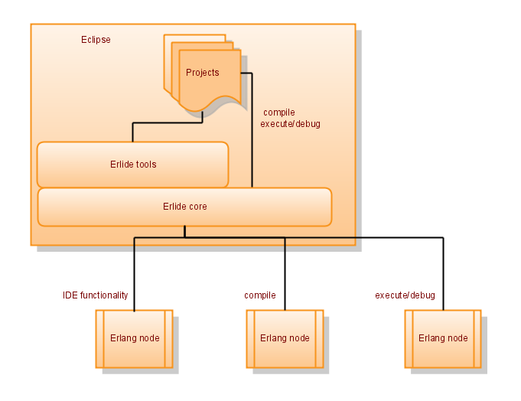
Architecture

Slide 9
Architecture
Erlang side provides services to Java side
  RPC
  event based
Infrastructure to make communication as seamless as possible
  implement Java interfaces in Erlang
Notes:
The Erlang side provides services either by RPC (this is most used at the moment) or by sending notifications when something changed. The challenge is to make this fit in the existing Eclipse infrastructure, which isn't trivial. Well, it would probably be a little easier if we could start over, given everything we learned since we started, but that's not really an option. Maybe something for version 2.0.

Slide 10
ErlIDE and OTP
Requires R11B-5 or later
Special versions of jinterface, scanner, parser, syntax_tools, edoc, debugger
Notes:
We have had to reimplement a lot of core functionality, because the existing one didn't match the requirements.
For example, the lexical scanner returns only line numbers and ignores whitespace and comments, which is okay when used as front end to a compiler, but for source code handling we need character position too in order to for example highlight a variable name; we also need to be able to reconstruct the source code from the parse tree, in order to be able to reformat the source.

Slide 11
Features
Editor
  Indentation of Erlang code
  Syntactic highlighting
  Bracket matching
  Automatic completion of erlang functions and records
  Selective display of functions and declarations (folding)
Indentation and code formatting
  Automatic indentation
  Formatting and pretty-printing

Slide 12
Features
Hover
  OTP documentation shown for external calls
  Show declaration of macros and records
Outline
  Code outline of the structure of an Erlang module
  Filtering of Erlang functions and declarations
  Quick outline for selecting Erlang function or declaration

Slide 13
Features
Navigation
  Go to declaration of function, macro or record
Project Import
  Erlang-aware import of projects
Creation wizards
  Create Erlang projects
  Create Erlang modules with code skeletons

Slide 14
Features
Debugger
  Erlang debugger within eclipse debugger framework
  Breakpoints, single-stepping
  Inspection and modification of local variables
  Distributed debugger, debug on multiple nodes

Slide 15
Features
Erlang runtime handling
  Provision for different runtimes, local or remote
  Develop on one runtime, test and debug on another
Warnings, errors, TO-DO-markers
  Show errors and warnings in code and in problems view
  Automatically mark and list comments with TODO and FIXME
  Erlang log printouts with link to code line

Slide 16
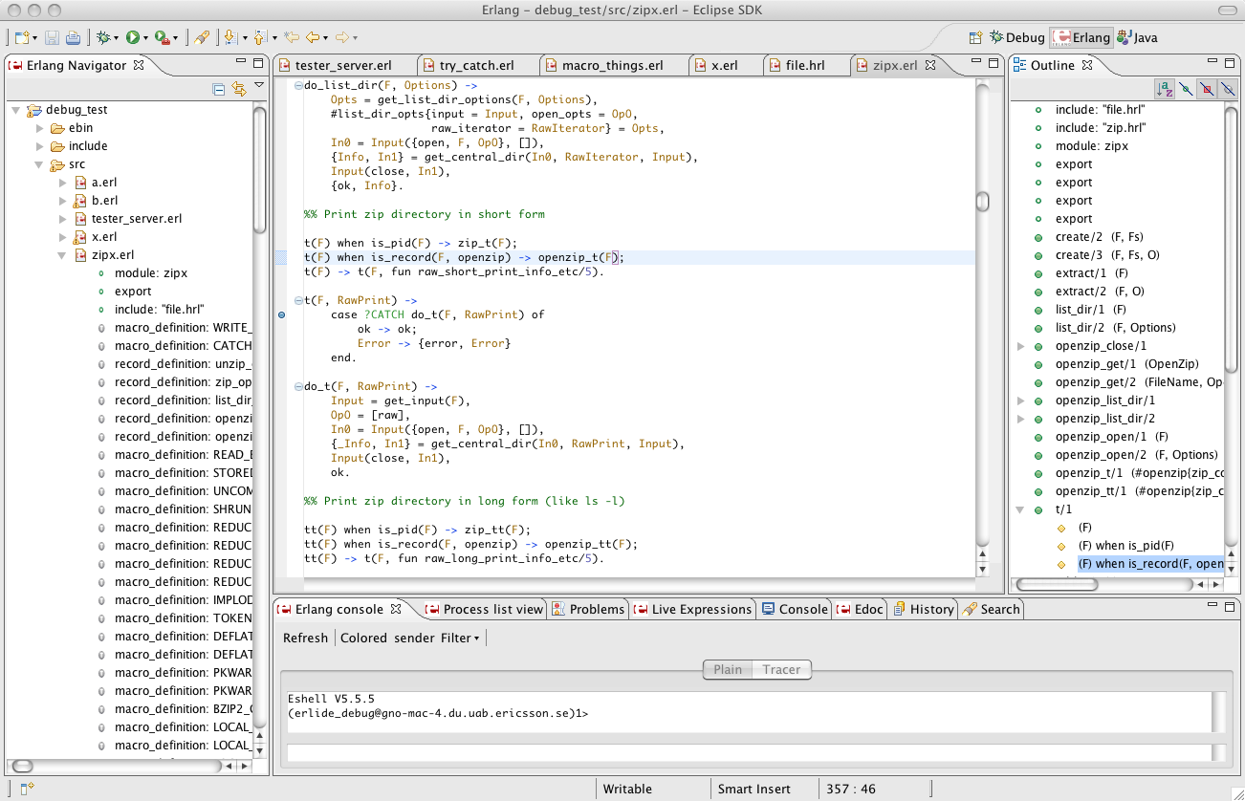
Demonstration

Slide 17
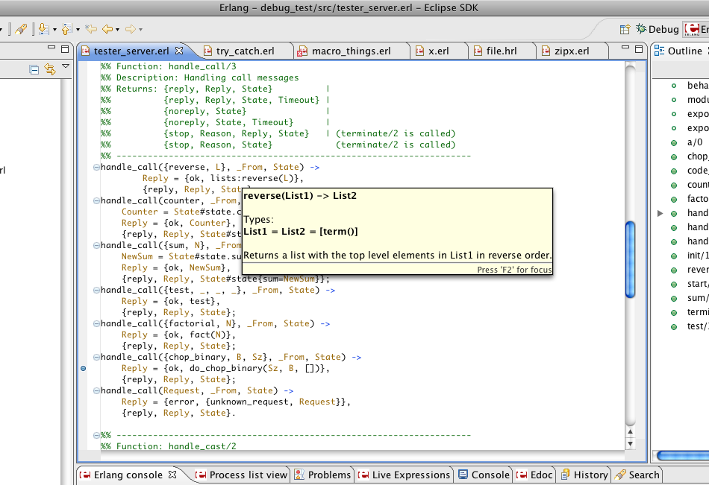
Demonstration

Slide 18
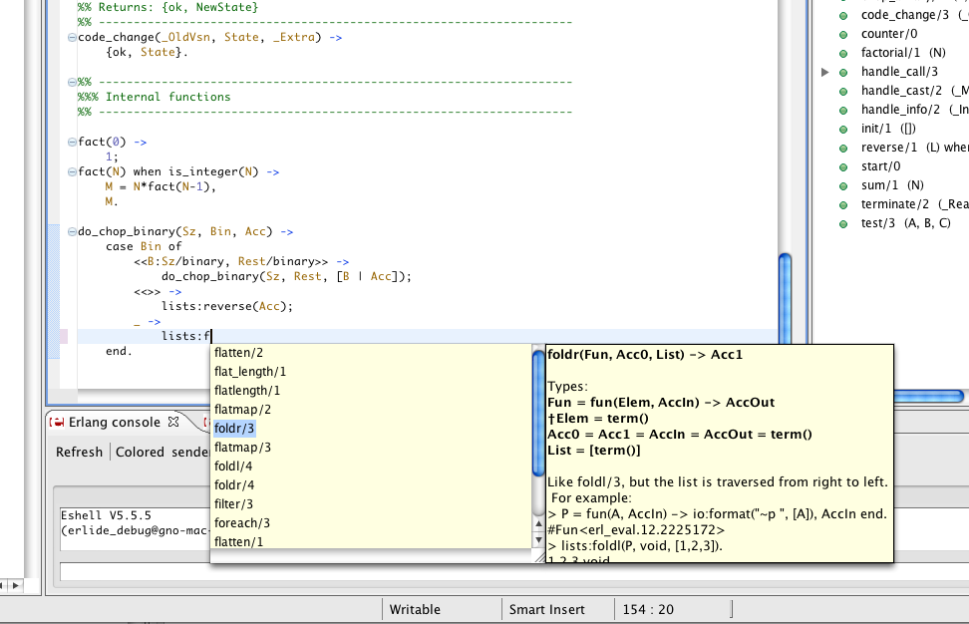
Demonstration

Slide 19
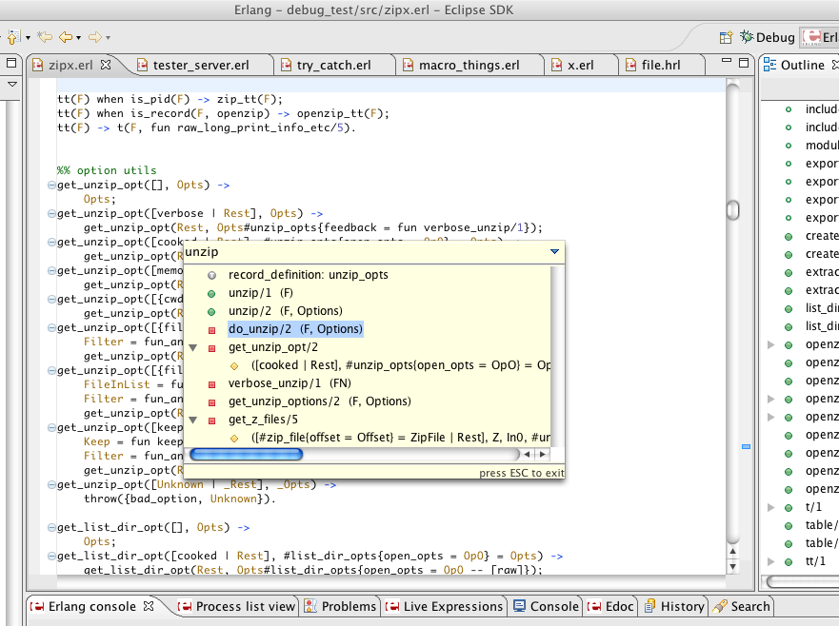
Demonstration

Slide 20
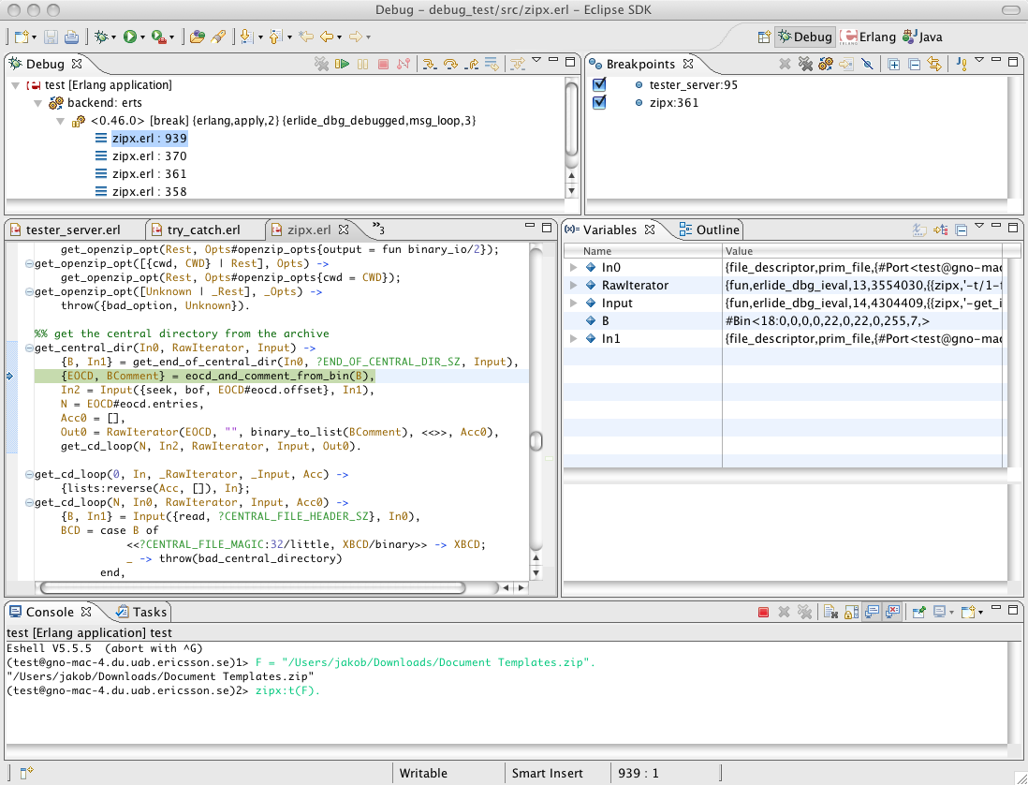
Demonstration

Slide 21
Some future features
Semantic highlighting in editor (function calls, variable usage, etc)
Show documentation of user functions
Erlang-aware search
Refactoring
xref-based indexing and searching
Tracing viewer
Syntax error correction
What tools do you need?
Notes:
We would love to get more feedback, and not only for bugs, but also for bigger features that you would find useful. The ones we can come up with may or may not be anchored in the way people work, so please let us know what you need.

Slide 22
Resources
http://erlide.sourceforge.net
http://erlide.sourceforge.net/update
http://eclipse.org
http://erlang.org

